Slide 1


3. OOPS, so intuitive!
Mrinal Vashisth
PhD Year 2, Computational Psychometrics, TSU, RF
M.Sc. Human Development: Genetics, Neuroscience and Psychology, TSU, RF
M.S. Applied Mathematics and Information Technology (Systems Biology and Bioinformatics), ITMO, RF
B.Tec. Biotechnology, JNU, RI

Slide 2
Things to ponder!
How can I avoid repetitions in the code?
How can I do typing and basic debugging within classes?
How can I represent the inherent structure of the world…
Is there intelligent code?
What is dynamic programming/ coding?
What is Inherent structure…
Inheritance
Thus, what are the attributes,

Slide 3
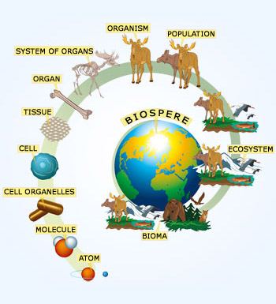
Observer
States
Processes
Properties
Relationships
Observed

Slide 4
Classes, Inheritance, Properties and Methods
Characteristics
Weird AI and statistical core
Mathematical problems
User interfaces
Algorithms
Natural phenomenon
.
.
.
The known universe
I/ O classes
Visualisation classess
Process functions

Slide 5
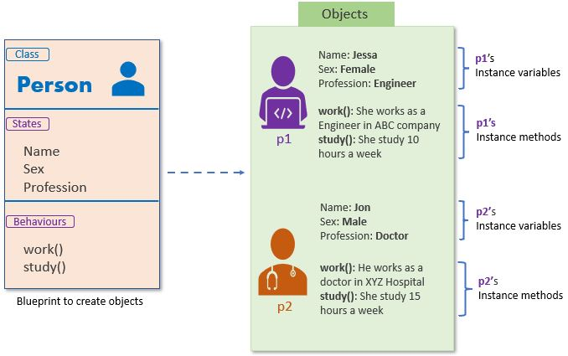
https://youtu.be/JeznW_7DlB0
(Those who want to study it exhaustively)
https://youtu.be/rJzjDszODTI
(for students who like to start right away, coding)
Assignment
https://pynative.com/python-classes-and-objects/
(for students who like to read)
Meanwhile…

Slide 6
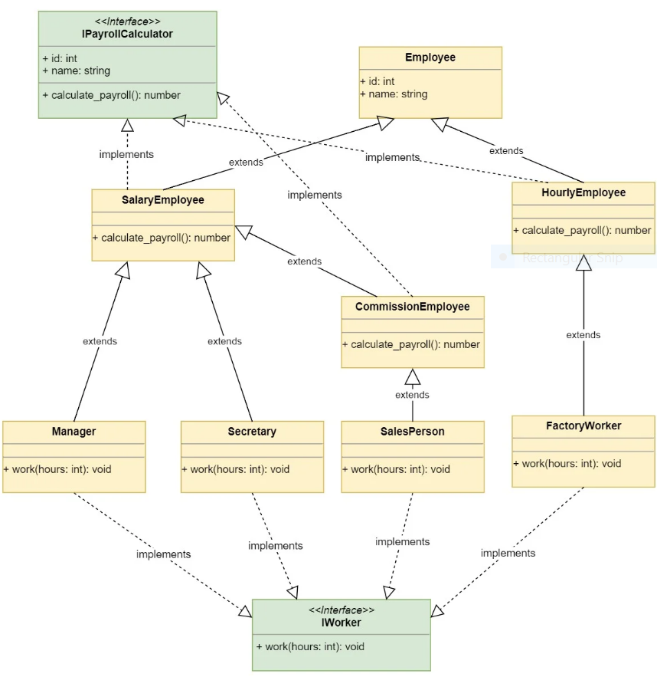
https://realpython.com/inheritance-composition-python/

Slide 7
Go to jupyter notebook 3.

Slide 8
Code Organization
The code is organized according to the project.
Start with thinking what classes, functions, or procedures you would require.
Then you make libraries according to that.
Then you package the libraries into software programs, binaries, or packages
We will look at these in the very last lectures.

Slide 9
https://www.kaggle.com/code/vencerlanz09/bird-classification-using-cnn-efficientnetb0/notebook
Let’s first look at an example of project organization.

Slide 10
Assignment
See slide 5

